Slide 1
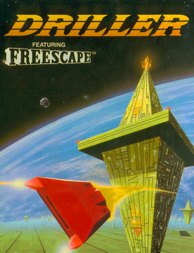
Port 1: Driller Remastered
CIS5014
Introduction to Level Design and Game Asset creation
ST20228851
Cerys Hopkins

Slide 2
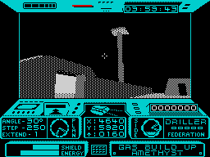
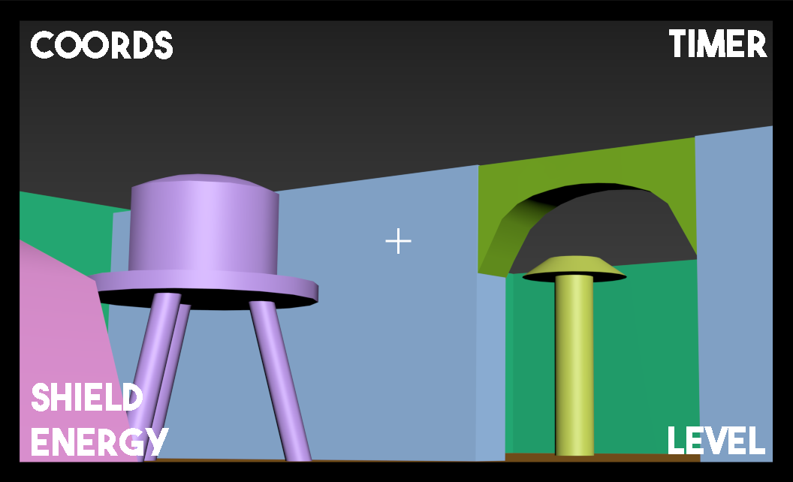
View changes
Previous screen view of Driller-
Old school look with the arcade machine overlay.
All the information clunked together.
Sketch Design of what my new
screen view will look like
Widen the screen, which will enhance player visibility.
The data from the bottom will move to the corners.
Added crosshair to show player where their aiming.
(Not Shown on Screen) an arrow showing the player the next place to go.

Slide 3
View changes
Made using 3ds Max with a screen shot from my ‘level 1’ and photoshop for the overlay information

Slide 4
Scene changes
Retouch layout.
Re-texture the game level.
Aiming for a more run down space station, as it is meant to be failing.
Added some more buildings/walls/things

Slide 5
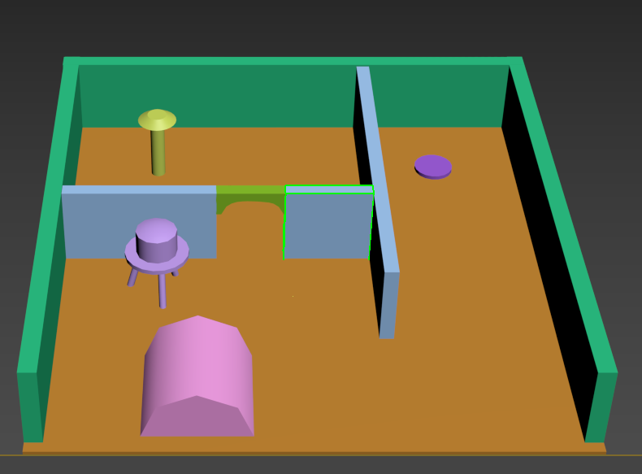
1st Level, Basic Sketch

Slide 6
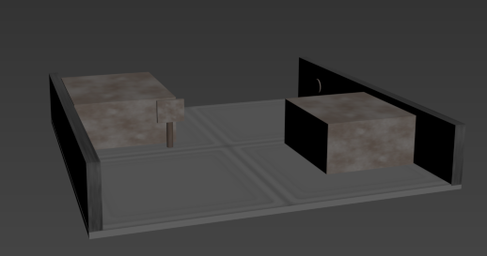
2nd Level, with textures

Slide 7
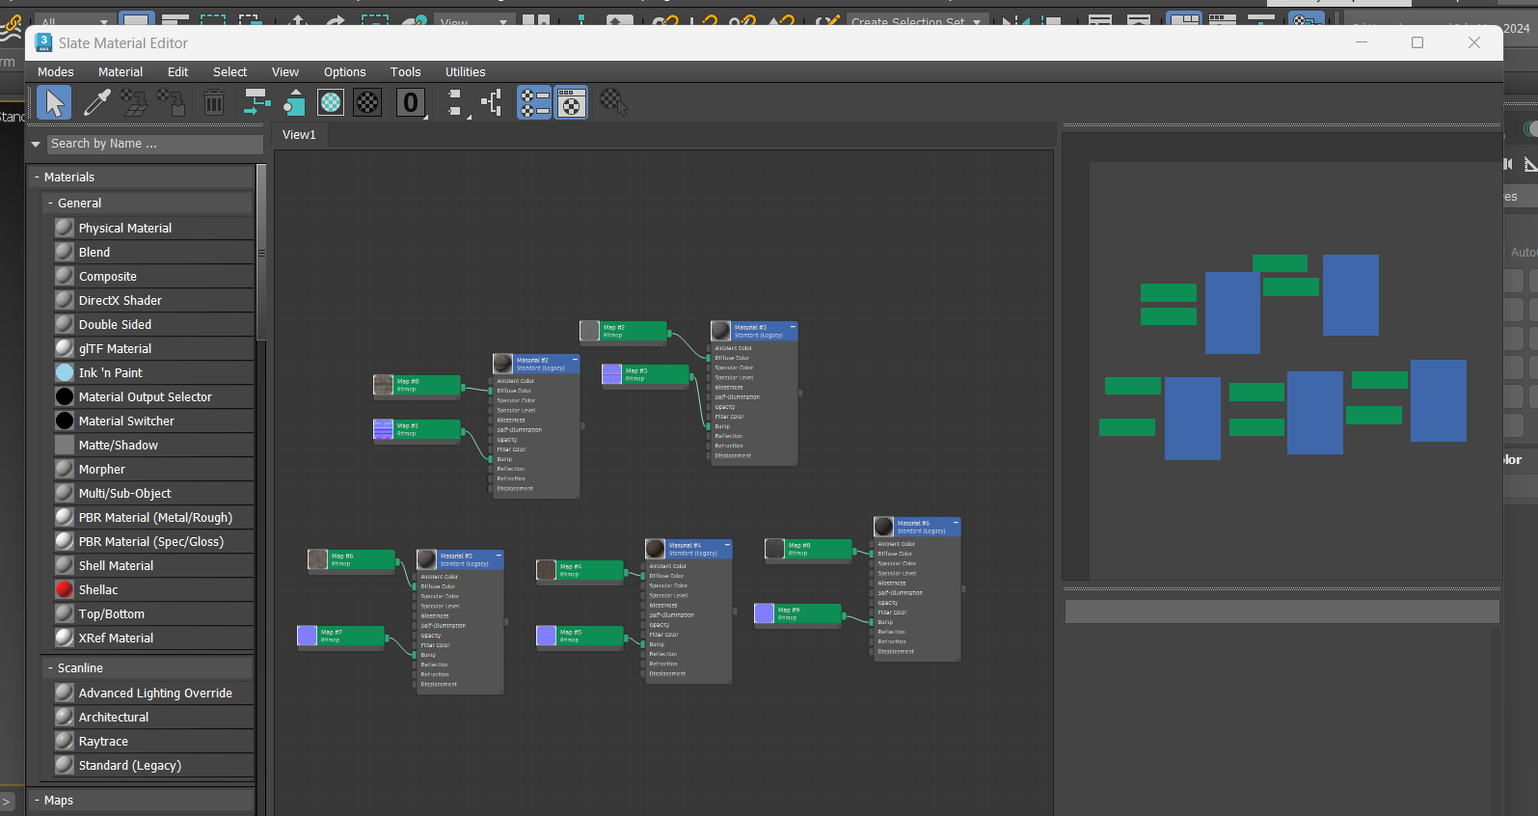
How I applied textures
Used Material Editor.
Textures found online.
Set up the textures, clicked on the object, then the texture, then the apply button.
Link to textures at the end of the power point.
Link to the videos I followed also at the end.

Slide 8
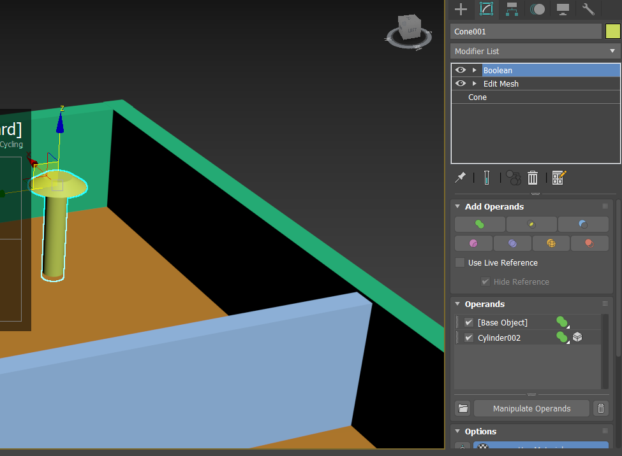
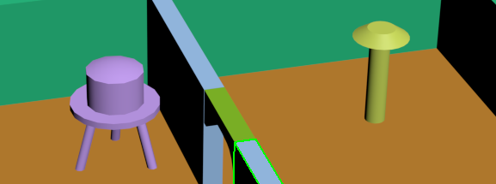
Added
Purple – oil/water tank. Made using the 'oil tank' preset and four cylinders. Connected using boolean and merge
Yellow – satellite tower/dish. Made using a cylinder and cone, joined together using boolean and merge
Green + Blue – new walls added and an archway. Adds to the atmosphere. All rectangles. Archway made using edit poly.

Slide 9
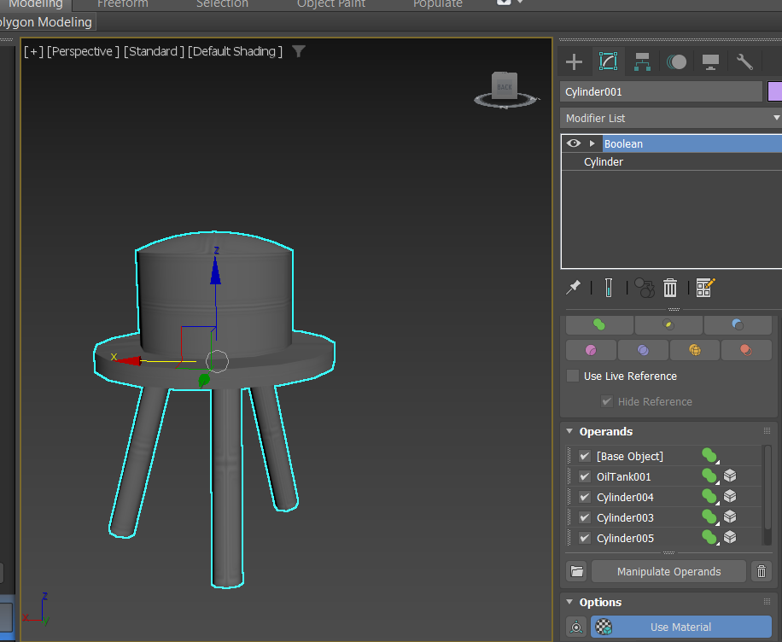
In-depth about the tools used
Boolean on the water/oil tank
Started with the oil tank preset from 3ds Max, shaped it using the length, width, height parameters.
Created the disk around using a cylinder and added that next, first Boolean merge.
Created the legs using cylinders too, tilted and shaped, then used shift and move to duplicate. Had to re-tilt the legs, lined it up and attached to the main body using Boolean merge again

Slide 10
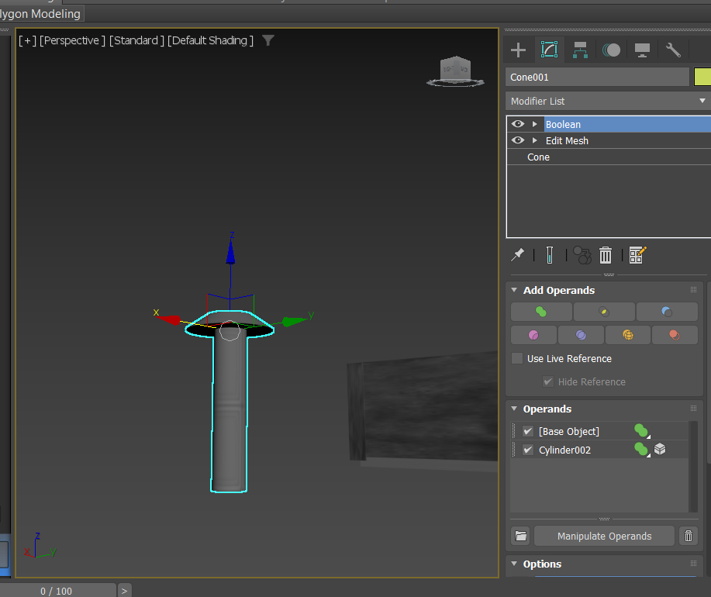
In-depth about the tools used
Boolean on satellite dish.
First made a cone with a flat top, to mimic the dish part of a satellite.
Second made a cylinder to be the base.
Third used Boolean and merge to join them.

Slide 11
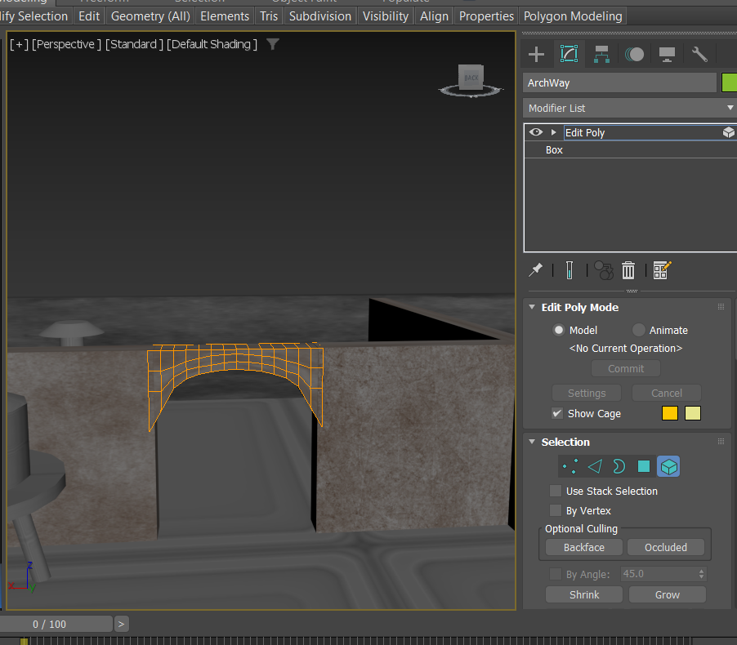
In-depth about the tools used
Edit Poly on the archway.
In between two walls, decided to have it this way as it would be easier. Created a rectangle and matched the width and height I wanted.
Tried a few different tactics I remembered from classes but went with moving the vertices up in a line at once and the moving them one by one. Painstaking and probably not completely level from one side to the other.

Slide 12
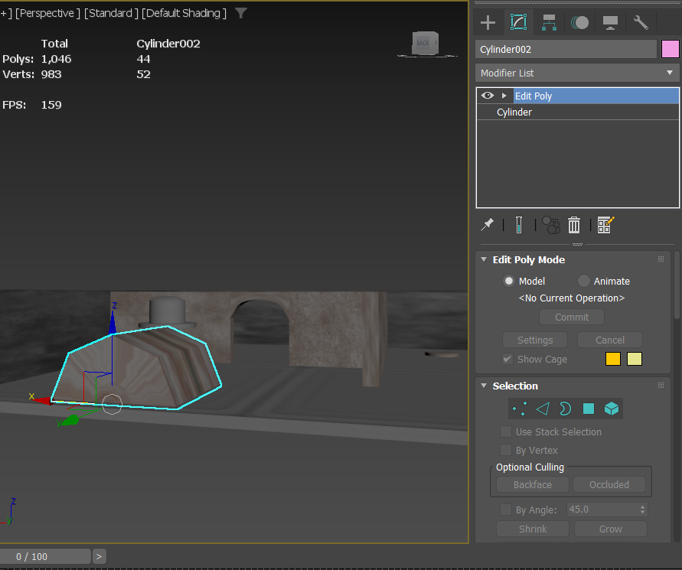
In-depth about the tools used
Edit Poly on the Building.
Used edit poly to delete the bottom half of the cylinder, as it wouldn't be seen. Then lowered the bunker building into the floor so there wouldn’t be any gaps in the mesh.

Slide 13
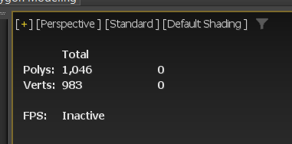
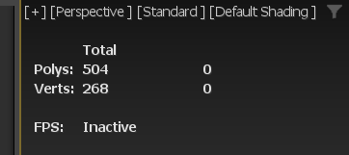
Poly Count
Level 1 – 1,046
Level 2 – 504
Total – 1,550

Slide 14
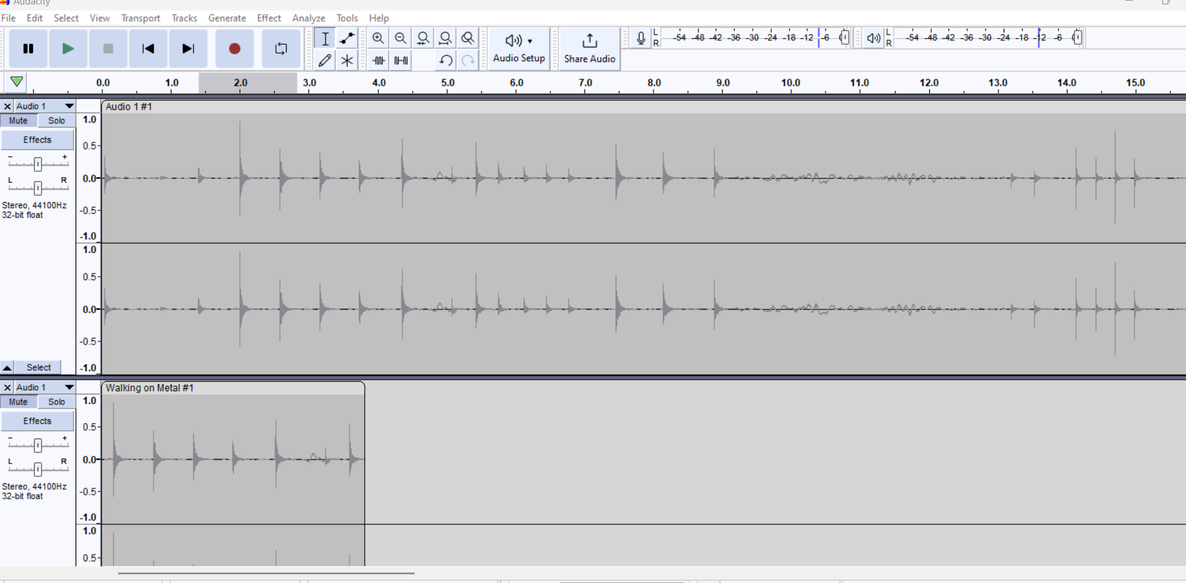

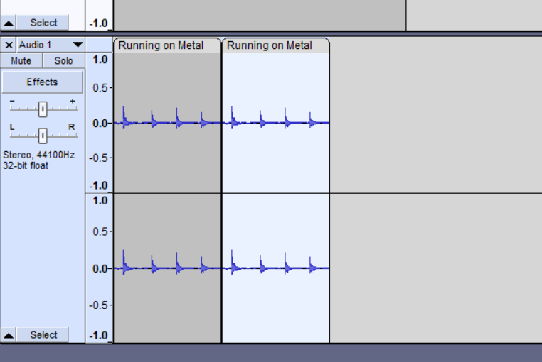
How I made audio
Using Audacity
Hitting random metal objects together
Walk sound First, Run second
Cut down the audio that failed and kept the best

Slide 15
Where I got textures from
Steel (walls) texture - https://freepbr.com/materials/used-stainless-steel2/
Rusted floor texture - https://freepbr.com/materials/rusting-textured-metal1/
Building texture - https://freepbr.com/materials/aluminum-squares-pbr/
Extra one - https://freepbr.com/materials/old-metal-slats1/

Slide 16
Videos I used
https://www.youtube.com/watch?v=yoXYd2I6hh8
https://www.youtube.com/watch?v=SQak9sQh8uw&t=683s

